Slide 1
Learning Methods

Slide 2
Basics
4 Blows at the back
3-4 Up
Make 2^{nds}
3-4 Down

Slide 3
Timeline of Techniques
Circle of Work
Rules
Blue Line
Place Notation
Plain Bob
Grandsire
Kent
Little Bob
Cambridge
London
Multispliced Minor
Handbells

Slide 4
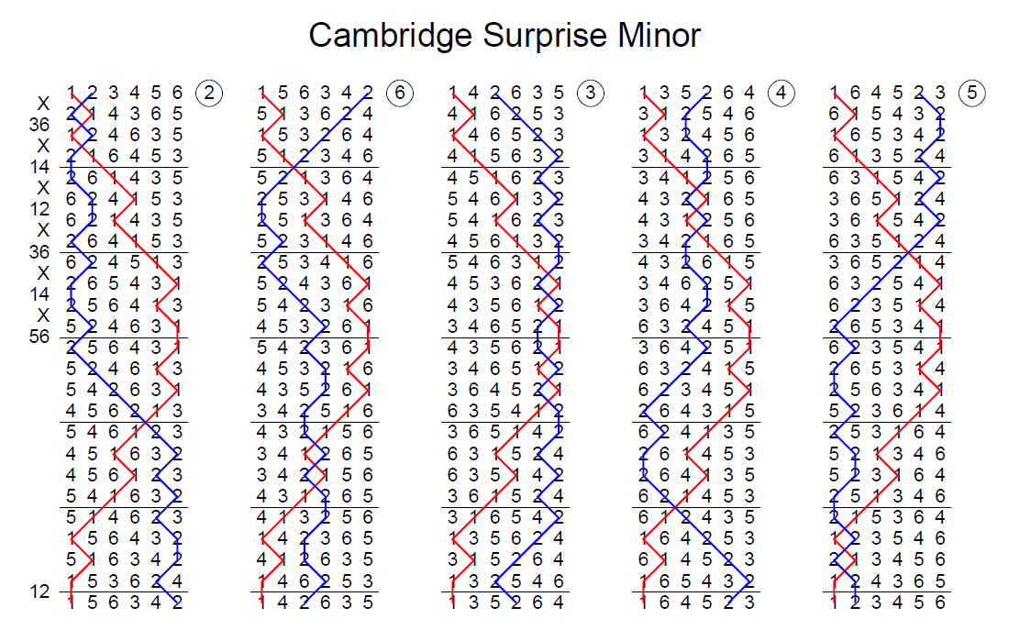
Terminology
Rounds
Place Bell
Place Notation
Half Lead
Lead End
Rounds

Slide 5
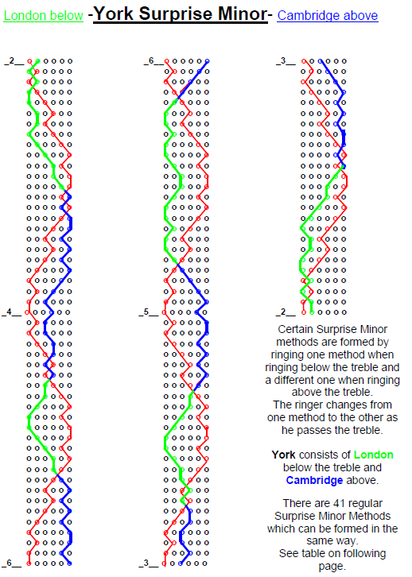
Above and Below

Slide 6
1 2 3 4 5 6
2 1 4 3 6 5
1 2 3 4 5 6
1 3 2 4 6 5
1 2 3 4 5 6
1 3 2 4 6 5
X
14
12

Slide 7
